Slide 1
Memory Management
Samia Shafique
United International University

Slide 2
Main memory
A program resides on a disk as binary executable file
To be executed the program must be brought into RAM
The CPU fetches instructions from RAM according to the value of the PC
The instruction operands may be needed to be fetched from RAM
After execution the results may be stored back to RAM

Slide 3
Memory Management
Ideally programmers want memory that is
private
large
fast
non volatile
Cheap

Slide 4
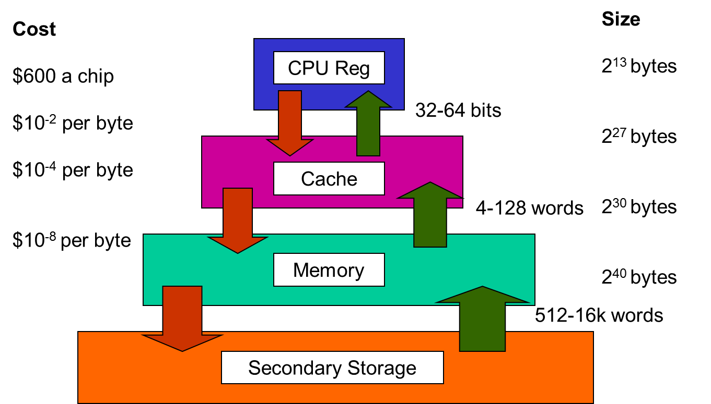
Memory management
But in real world…
It is the job of the operating system to
abstract this hierarchy into a useful model
and then manage the abstraction.

Slide 5
Memory Management
The part of the operating system that manages the memory hierarchy is called the memory manager.
Keep track of used memory
Allocate memory to processes
Deallocate it when they are done

Slide 6
objective
In this chapter we will study
how operating systems create abstractions from memory
and how they manage them.
The focus will be on the programmer's model of main memory
Memory Abstraction: the view/illusion of the memory presented to the programmer by the OS

Slide 7
No memory abstraction
The simplest memory abstraction
Every program simply saw the physical memory
MOV REG1, 1000
move the contents of physical memory location 1000 to REGISTER1
Model of memory presented to the programmer is simply physical memory
Not possible to have 2 running programs in memory at the same time

Slide 8
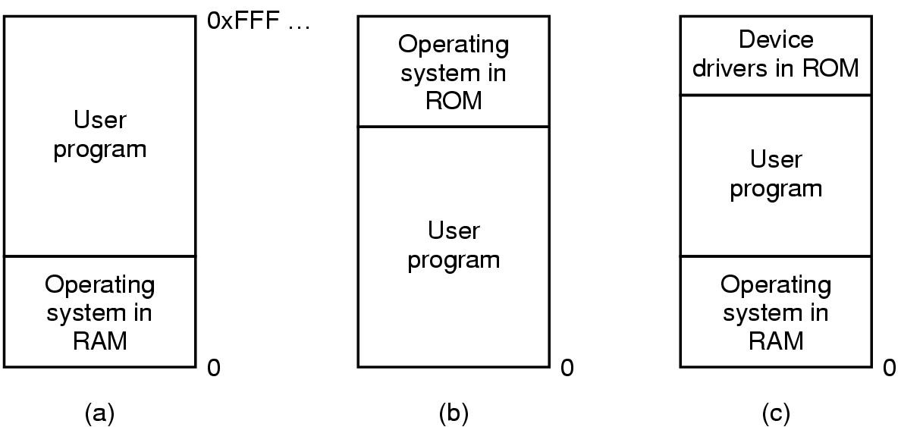
One Program at a time in memory
Three simple ways of organizing memory with an operating system and one user process

Slide 9
Really want to run more than one program
Could swap new program into memory from disk and send old one to disk
Not really concurrent

Slide 10
IBM static relocation idea
IBM 360 –
divide memory into 2 KB blocks,
associate a 4 bit protection key with chunk.
Keep keys in registers.
Put key into PSW (Program Status Word) for program
Hardware prevents program from accessing block with another protection key

Slide 11
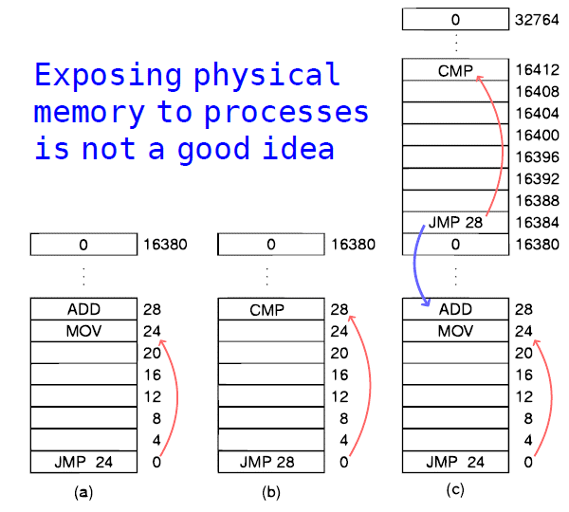
Problem with relocation
JMP 28 in program cause program counter to move to ADD instruction in location 28.
Program crashes

Slide 12
Conclusion
exposing physical memory to processes has several major drawbacks.
if user programs can address every byte of memory, they can easily trash the operating system intentionally or by accident
it is difficult to have multiple programs running at once

Slide 13
Static relocation
Static relocation – load first instruction of program at address x, and add x to every subsequent address during loading
This is too slow and
Not all addresses can be modified
Mov register 1, 28 can’t be modified

Slide 14
Address Space
Two problems have to be solved:
Protection
Relocation
Solution: Create abstract memory space for program to exist in
Each program has its own independent set of addresses
The addresses are different for each program
Call it the address space of the program

Slide 15
Base and Limit Registers
A form of dynamic relocation
Base contains beginning address of program
Limit contains length of program
Program references memory, adds base address to address generated by process. Checks to see if address is larger then limit. If so, generates fault

Slide 16
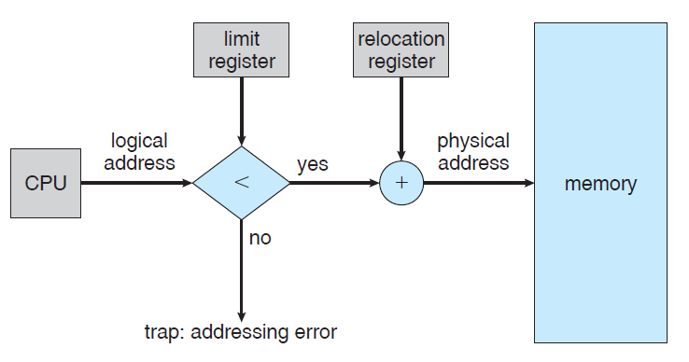
Base and Limit Registers

Slide 17
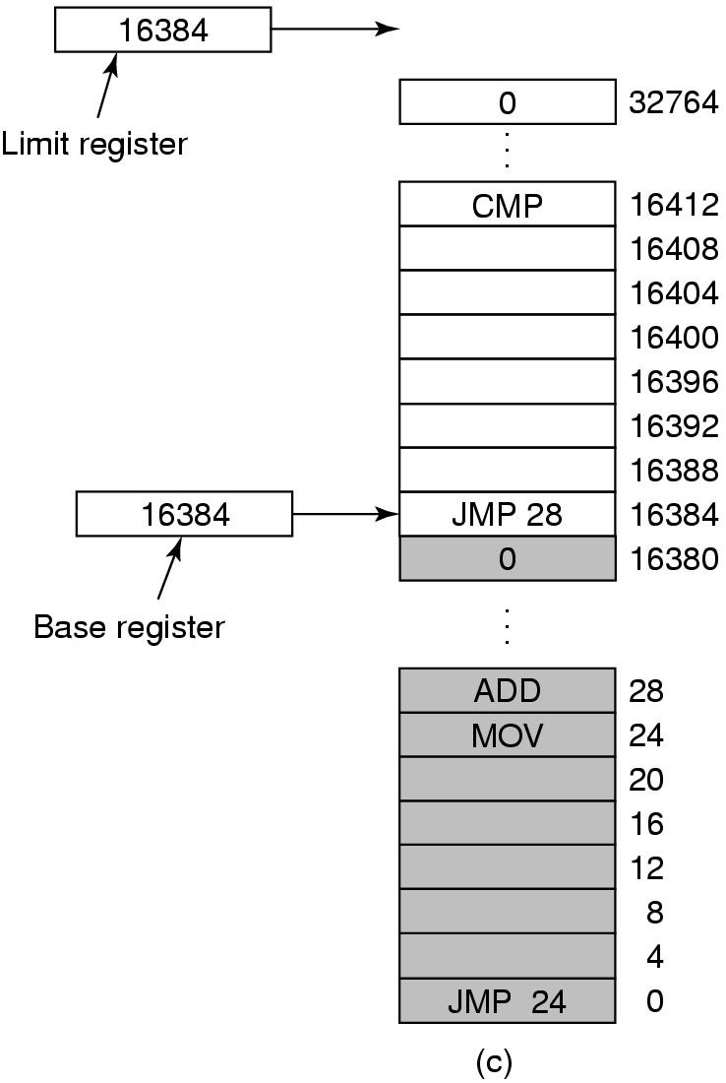
Base and Limit Registers
Add 16384 to JMP 28.
Hardware adds 16384 to 28 resulting in JMP 16412

Slide 18
Base and Limit Registers
Disadvantage-addition and comparison have to be done on every instruction

Slide 19
How to run more programs then fit in main memory at once
Can’t keep all processes in main memory
Too many (hundreds)
Too big (eg 200MB program)
Two approaches
Swap-bring program in and run it for a while
Virtual memory – allow program to run even if only part of it is in main memory

Slide 20
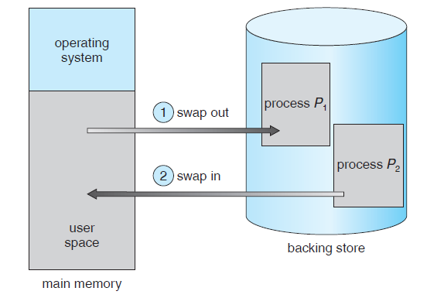
Swapping
Bringing in each process in its entirety,
running it for a while
then putting it back on the disk

Slide 21
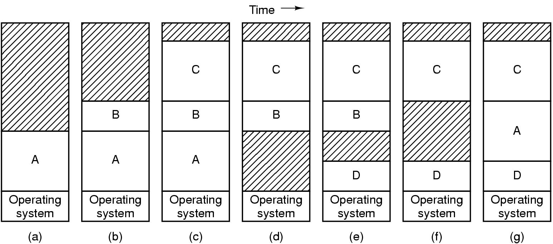
Swapping

Slide 22
swapping
Memory allocation changes as
processes come into memory
leave memory
Shaded regions are unused memory
Hole – block of available memory; holes of various size are scattered throughout memory
When a process arrives, it is allocated memory from a hole large enough to accommodate it
Operating system maintains information about: a) allocated partitions b) free partitions (hole)

Slide 23
swapping
When swapping creates multiple holes in memory, it is possible to combine them all into one big one by moving all the processes downward as far as possible.
This technique is known as memory compaction

Slide 24
Programs grow as they execute
Stack (return addresses and local variables)
Data segment (heap for variables which are dynamically allocated and released)
Good idea to allocate extra memory for both
When program goes to disk, don’t bring holes along with it!!

Slide 25
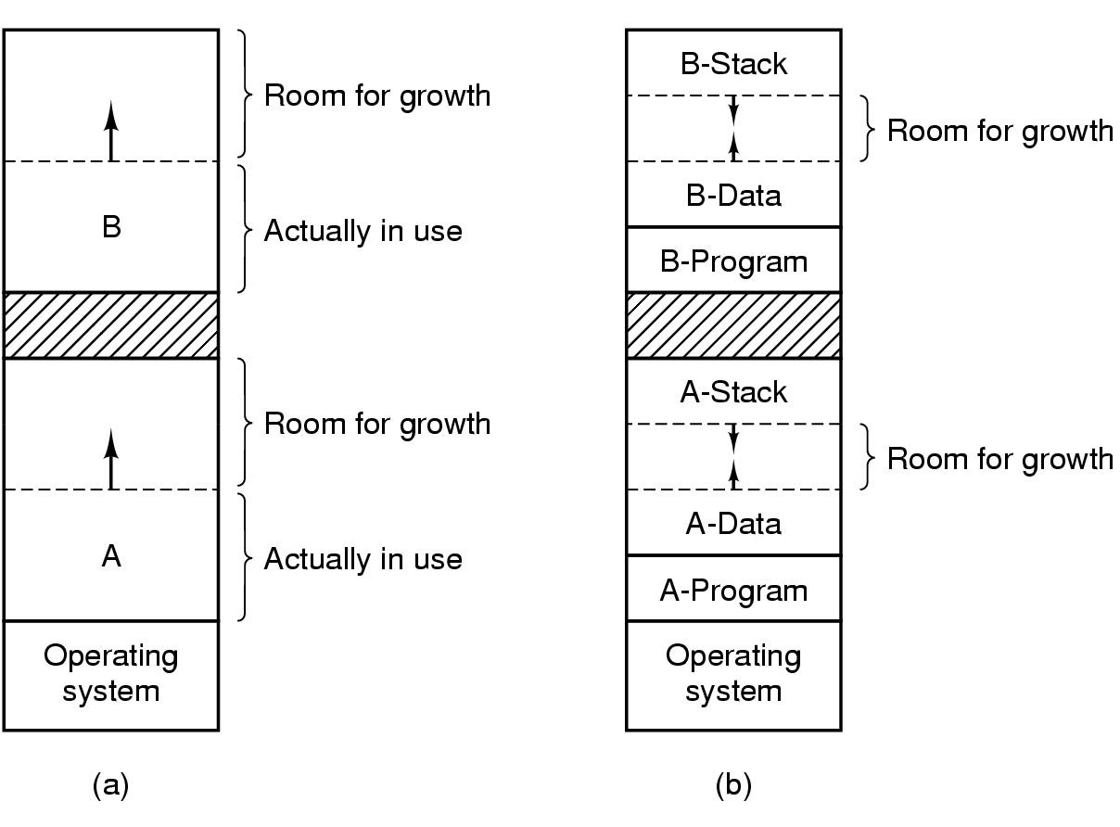
2 ways to allocate space for growth
Allocating space for growing data segment
Allocating space for growing stack & data segment

Slide 26
Managing Free Memory
Operating system maintains information about
Allocated memory
Free memory (holes)
Two techniques to keep track of memory usage
Bitmaps
Linked lists

Slide 27
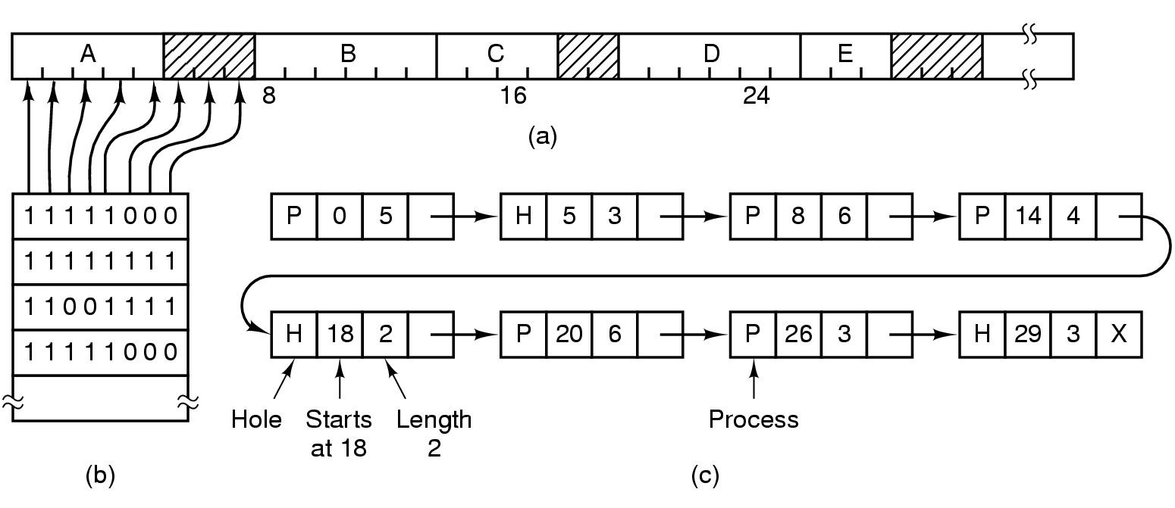
Bitmaps
Picture of memory
Each bit in bitmap corresponds to a unit of storage (eg. bytes) in memory
Linked list: P - process, H - hole

Slide 28
Bitmaps
The good – compact way to keep track of memory
The bad – need to search memory for k consecutive zeros to bring in a file k units long
Units can be bits or bytes or …….

Slide 29
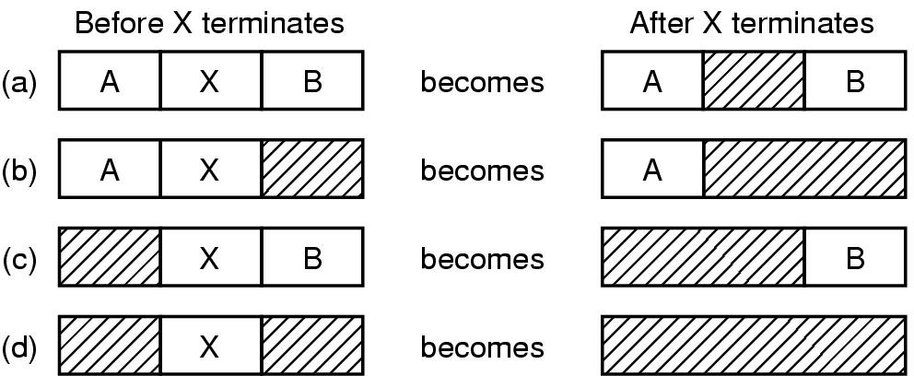
Linked Lists
Four neighbor combinations for terminating process, X.

Slide 30
Linked Lists
Might want to use doubly linked lists to merge holes more easily
Algorithms to fill in the holes in memory
Next fit
Best fit
Worst fit
Quick fit

Slide 31
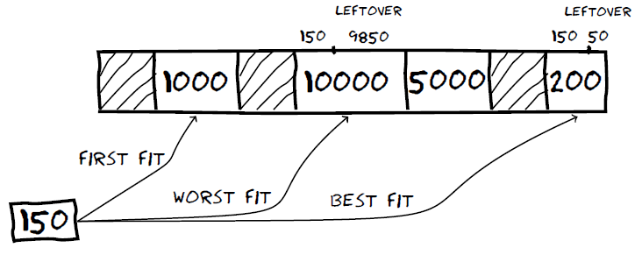
Linked lists
Memory allocation algorithms : First fit, next fit, best fit, worst fit, quick fit

Slide 32
The fits
First fit-fast
Next fit-starts search wherever it is
Slightly worse
Best fit-smallest hole that fits
Slower, results in a bunch of small holes (i.e. worse algorithm)
Worst fit-largest hole that fits
Not good (simulation results)
Quick fit- keep list of common sizes
Quick, but can’t find neighbors to merge with

Slide 33
The fits
Conclusion – the fits couldn’t out-smart the unknowable distribution of hole sizes.
The extra work to deal with something which you can’t predict failed to produce good results

